Slide 1
Hoarseness Of Voice
Saba Yahya Abdelnabi

Slide 2
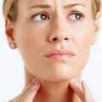

Slide 3
Introduction
Human voice is so complex that it not only conveys meaning, it also is capable of conveying subtle emotions. It is the most important physiological aspect that effectively starts to function immediately after birth.

Slide 4
What is hoarseness?
Hoarseness is an abnormal deep, harsh voice caused by a variety of conditions.

Slide 5
What causes hoarseness?
Hoarseness is generally caused by irritation of, or injury to, the vocal cords. The larynx (also referred to as the voice box), is the portion of the respiratory (breathing) tract containing the vocal cords. The cartilaginous outer wall of the larynx is commonly referred to as the "Adams apple." The vocal cords are two bands of muscle that form a "V" inside the larynx. When we sing or speak, the vocal cords vibrate and produce sound.

Slide 6
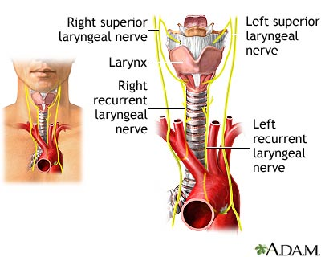

Slide 7
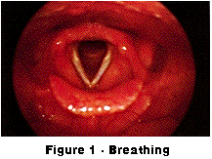
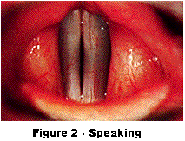

Slide 8
Hoarseness can be caused by a number of conditions:
1.acute laryngitis (inflammation of the vocal cords).
2.overuse or misuse of the voice (such as from yelling or singing).
3.benign vocal cord nodules or polyps.
4.GERD.
5.Allergies.
6.Vocal cord paralysis ( main cause Lf . Recurrent .N palsy .)
7.inhalation of irritants/smoking

Slide 9
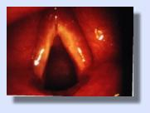
Acute Laryngitis

Slide 10
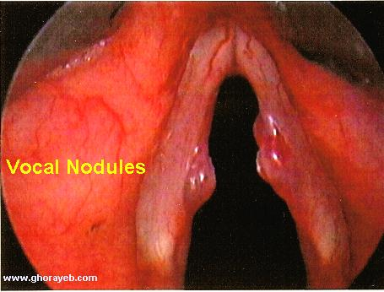
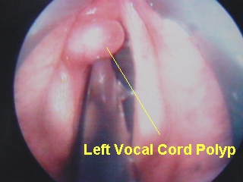

Slide 11
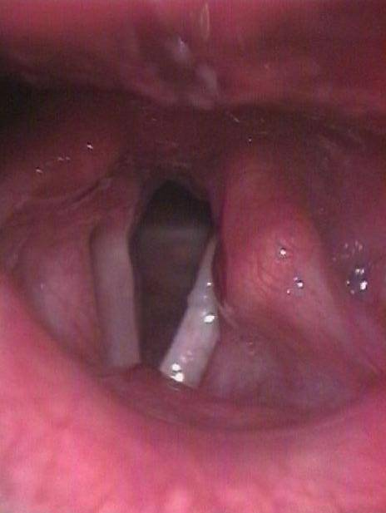
Vocal Cord Paralysis

Slide 12
8.Thyroid problems.
9.Trauma to the larynx/vocal cords.
10.Neurological conditions (Parkinson's disease and strokes).
11.Cancer of the larynx.

Slide 13
What are the signs and symptoms of hoarseness?
Hoarseness typically gives the voice a raspy and harsh quality, though it may also cause a change in the pitch or volume of the voice. The rapidity of onset and any associated symptoms will depend on the underlying cause leading to hoarseness.

Slide 14
SYMPTOMS:
  1.Aphonia / dysphonia.
  2.Cough : dry, painful & irritating.
  3.Stridor : rare but potentially serious.
  4.Pain throat : after talking.

Slide 15
How are the causes of hoarseness diagnosed?
ask the patient questions about their hoarseness and any other associated symptoms.
A physical exam will focus on the head and neck. Often times, a diagnosis can be made based on this initial assessment. In some instances, a long lighted flexible tube (fiberoptic scope) will be inserted into the throat to directly visualize the vocal cords if no other cause is initially identified. Individuals with hoarseness that lasts longer than 2-3 weeks should have a consultation with an otolaryngologist.

Slide 16
1.Indirect laryngoscopy.
2.Examination of neck, chest, cardiovascular & neurological symptom( to find the cause of laryngeal paralysis).
3.Laboratory investigations & radiological examination.
4.Direct laryngoscopy & microlaryngoscopy.
5.Bronchoscopy & oesophagoscopy ( in case paralytic lesions to exclude malignancy).

Slide 17
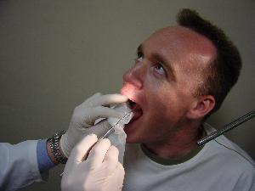
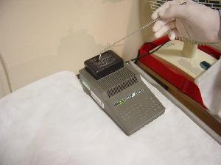
  Indirect laryngoscopy : shows a red swollen larynx.
  Sometimes, present stringy mucus between cords.

Slide 18
What is the treatment for hoarseness?
The treatment for hoarseness depends on the underlying cause:
1.Acute laryngitis caused by an upper respiratory tract infection will usually improve on its own as the infection clears the body.
2.Conservative treatment with cough suppressants and humidified air can be helpful.

Slide 19
3.Voice rest is also recommended in order to avoid further irritation or injury to the vocal cords.
4.Antibiotics are not indicated for most cases of acute laryngitis.
5.Smoking cessation is suggested for those individuals that smoke.

Slide 20
Individuals with hoarseness caused by vocal overuse or misuse should adhere to voice rest, as serious injury can occur to the vocal cords if the voice is strenuously used during episodes of acute laryngitis.

Slide 21
6.Medications for gastroesophageal reflux (GERD) or allergies can treat hoarseness if either of these is found to be the underlying cause.
In some instances, surgery may be necessary for benign nodules or polyps, trauma to the larynx/vocal cords and for cancer of the larynx.

Slide 22


